Slide 1
Recurrent Neural Network (RNN)

Slide 2
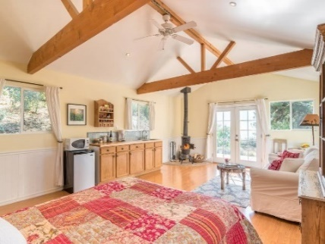
Supervised Learning
Traditional pattern recognition models work with hand crafted features and relatively simple trainable classifiers.
Limitations
Very tedious and costly to develop hand crafted features.
The hand-crafted features are usually highly dependents on one application.
Trainable Classifier
(e.g. SVM, Random Forrest)
Extract Hand Crafted Features
Output
(e.g. Outdoor Yes or No)

Slide 3




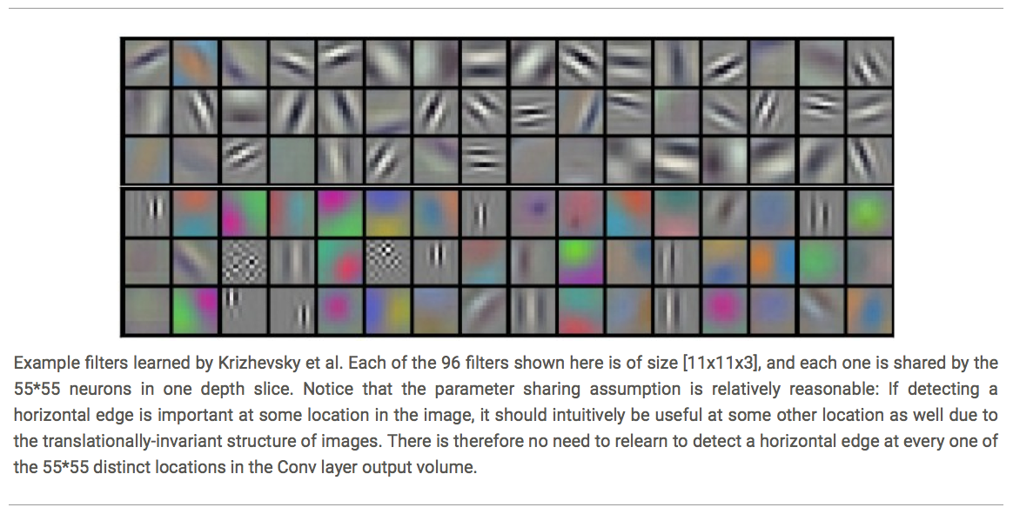













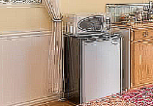


Deep Learning
Deep learning has an inbuilt automatic multi stage feature learning process that learns rich hierarchical representations (i.e. features).
Low Level Features
Mid Level Features
High Level Features
Trainable Classifier
Output
(e.g. outdoor, indoor)

Slide 4
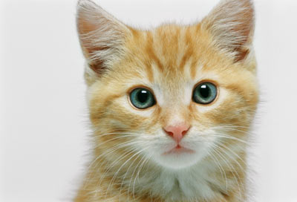
The whole CNN
Property 1
Some patterns are much smaller than the whole image
Convolution
Property 2
Max Pooling
The same patterns appear in different regions.
Can repeat many times
Property 3
Convolution
Subsampling the pixels will not change the object
Max Pooling
Flatten

Slide 5






Deep Auto-encoder
Symmetric is not necessary.
Of course, the auto-encoder can be deep
As close as possible
…
…
Layer
Layer
Output Layer
Input Layer
Layer
bottle
Layer
Layer
Layer
$$W_{2}^{T}$$
$$W_{1}$$
$$W_{2}$$
$$W_{1}^{T}$$
Initialize by RBM layer-by-layer
$$x$$
Code
$$\hat{x}$$
Reference: Hinton, Geoffrey E., and Ruslan R. Salakhutdinov. "Reducing the dimensionality of data with neural networks." Science 313.5786 (2006): 504-507
Notes:
codes

Slide 6

Example Application
Slot Filling
I would like to arrive Auckland on May 2nd.
ticket booking system
Destination:
Auckland
Slot
time of arrival:
May 2nd
Notes:
https://catalog.ldc.upenn.edu/docs/LDC93S4B/corpus.html

Slide 7
Example Application
Solving slot filling by Feedforward network?
Input: a word
(Each word is represented as a vector)
Auckland

Slide 8
1-of-N encoding
How to represent each word as a vector?
1-of-N Encoding
lexicon = {apple, bag, cat, dog, elephant}
The vector is lexicon size.
apple = [ 1 0 0 0 0]
bag = [ 0 1 0 0 0]
Each dimension corresponds to a word in the lexicon
cat = [ 0 0 1 0 0]
The dimension for the word is 1, and others are 0
dog = [ 0 0 0 1 0]
elephant = [ 0 0 0 0 1]
Notes:
Can be very large

Slide 9
Beyond 1-of-N encoding
Dimension for “Other”
Word hashing
apple
0
a-a-a
0
bag
0
a-a-b
0
…
…
cat
0
a-p-p
1
dog
0
…
…
…
26 X 26 X 26
elephant
0
p-l-e
1
…
…
p-p-l
1
“other”
1
…
…
w = “apple”
w = “Gandalf”
w = “Sauron”

Slide 10
Example Application
time of departure
destination
Solving slot filling by Feedforward network?
Input: a word
(Each word is represented as a vector)
Output:
Probability distribution that the input word belonging to the slots
Auckland

Slide 11
Example Application
time of departure
dest
arrive AKL on November 2nd
other
dest
other
time
time
Problem?
leave AKL on May 2nd
place of departure
Neural network needs memory!
AKL

Slide 12
Recurrent Neural Network (RNN)
The output of hidden layer are stored in the memory.
store
Memory can be considered as another input.

Slide 13





Example
Input sequence:
$$\left[\begin{aligned}1 \\ 1\end{aligned}\right]$$
$$\left[\begin{aligned}1 \\ 1\end{aligned}\right]$$
$$\left[\begin{aligned}2 \\ 2\end{aligned}\right]$$
$$……$$
output sequence:
$$\left[\begin{aligned}4 \\ 4\end{aligned}\right]$$
4
4
store
2
2
given Initial values
0
0
All the weights are “1”, no bias
1
1
All activation functions are linear

Slide 14

Example
Input sequence:
$$\left[\begin{aligned}1 \\ 1\end{aligned}\right]$$
$$\left[\begin{aligned}1 \\ 1\end{aligned}\right]$$
$$\left[\begin{aligned}2 \\ 2\end{aligned}\right]$$
$$……$$
output sequence:
$$\left[\begin{aligned}4 \\ 4\end{aligned}\right]$$
$$\left[\begin{aligned}12 \\ 12\end{aligned}\right]$$
12
12
store
6
6
2
2
All the weights are “1”, no bias
1
1
All activation functions are linear

Slide 15

Example
Input sequence:
$$\left[\begin{aligned}1 \\ 1\end{aligned}\right]$$
$$\left[\begin{aligned}1 \\ 1\end{aligned}\right]$$
$$\left[\begin{aligned}2 \\ 2\end{aligned}\right]$$
$$……$$
output sequence:
$$\left[\begin{aligned}4 \\ 4\end{aligned}\right]$$
$$\left[\begin{aligned}12 \\ 12\end{aligned}\right]$$
$$\left[\begin{aligned}32 \\ 32\end{aligned}\right]$$
Changing the sequence order will change the output.
32
32
store
16
16
6
6
All the weights are “1”, no bias
2
2
All activation functions are linear

Slide 16
RNN
The same network is used again and again， e.g., 3 times in this figures, each time is with the same parameters
Probability of “arrive” in each slot
Probability of “AKL” in each slot
Probability of “on” in each slot
y¹
y²
y³
store
store
a¹
a²
a³
a¹
a²
x¹
x²
x³
arrive AKL on May 2nd
Notes:
General idea

Slide 17
RNN
Different
Prob of “leave” in each slot
Prob of “AKL” in each slot
Prob of “arrive” in each slot
Prob of “AKL” in each slot
y²
……
y²
……
y¹
y¹
store
store
a¹
a²
a¹
a²
a¹
……
a¹
……
x¹
x²
……
x¹
x²
……
leave
AKL
arrive
AKL
The values stored in the memory is different.
Notes:
Output y^{i} depends on x¹, x², …… x^{i}
The same input can have totoally different output.

Slide 18
Of course it can be deep …
y^{t}
y^{t+1}
y^{t+2}
……
……
……
……
……
……
……
……
……
x^{t}
x^{t+1}
x^{t+2}

Slide 19
Elman Network & Jordan Network
Elman Network
Jordan Network
y^{t}
y^{t+1}
y^{t}
y^{t+1}
W^{h}
Wº
Wº
Wº
Wº
……
……
……
……
W^{h}
W^{i}
W^{i}
W^{i}
W^{i}
x^{t}
x^{t+1}
x^{t}
x^{t+1}
Notes:
Elman is worse than Jordan because the latter has label to supervise the model

Slide 20
Bidirectional RNN
……
x^{t}
x^{t+1}
x^{t+2}
……
y^{t}
y^{t+1}
y^{t+2}
……
……
x^{t}
x^{t+1}
x^{t+2}
Notes:
To determine yi, you have to consider a lot ……
You should see the whole sequence

Slide 21
Long Short-term Memory (LSTM)
Other part of the network
Special Neuron:
4 inputs,
1 output
Signal control the output gate
Output Gate
(Other part of the network)
Memory
Cell
Forget Gate
Signal control the forget gate
(Other part of the network)
Signal control the input gate
Input Gate
LSTM
(Other part of the network)
Other part of the network
Notes:
Normal neuron
1 input, 1 output
This one
4 input, 1 output
RNN is the simplest memory model

Slide 22
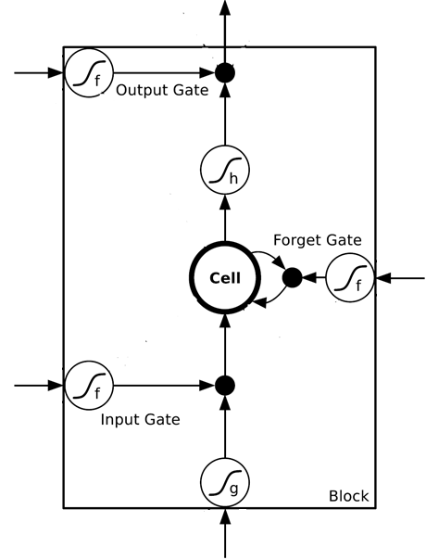
$$a$$
$$=h\left(c^{′}\right)f\left(z_{o}\right)$$
$$z_{o}$$
multiply
Activation function f is usually a sigmoid function
$$f\left(z_{o}\right)$$
$$h\left(c^{′}\right)$$
Between 0 and 1
Mimic open and close gate
$$c$$
$$f\left(z_{f}\right)$$
c
$$c^{′}$$
$$z_{f}$$
$$cf\left(z_{f}\right)$$
$$c^{′}=g\left(z\right)f\left(z_{i}\right)+cf\left(z_{f}\right)$$
$$f\left(z_{i}\right)$$
$$g\left(z\right)f\left(z_{i}\right)$$
$$z_{i}$$
multiply
$$g\left(z\right)$$
$$z$$

Slide 23




LSTM - Example
0
0
3
3
7
7
7
0
6
$$x_{1}$$
1
0
0
3
1
0
2
0
0
4
1
0
2
0
0
1
0
1
3
-1
0
6
1
0
1
0
1
$$x_{2}$$
$$x_{3}$$
$$y$$
0
0
0
0
0
7
0
0
6
When x₂ = 1, add the numbers of x₁ into the memory
When x₂ = -1, reset the memory
When x₃ = 1, output the number in the memory.
Notes:
0 is the initial memory, and three lines belong to the function, i.e., y =f(x)= f(x1,x2,x3)

Slide 24






x₁
0
y
$$\text{y}=h\left(c^{′}\right)f\left(z_{o}\right)$$
$$y$$
0
0
0
7
0
x₂
0
+
x₃
100
$$c^{′}=g\left(z\right)f\left(z_{i}\right)+cf\left(z_{f}\right)$$
0
x₁
1
-10
100
0
0
+
x₂
x₁
0
x₃
x₂
100
+
10
1
x₃
0
1
-10
+
$$x_{1}$$
3
1
0
4
1
0
2
0
0
1
0
1
3
-1
0
1
0
0
0
$$x_{2}$$
x₁
x₂
x₃
1
$$x_{3}$$
Notes:
Look at the sequence first

Slide 25
3
0
≈0
y
$$y$$
0
0
0
7
0
1
0
+
≈0
3
0
100
0
3
1
-10
0
100
0
3
+
1
3
≈1
0
0
100
≈1
3
1
+
10
1
3
0
0
1
-10
+
$$x_{1}$$
3
1
0
4
1
0
2
0
0
1
0
1
3
-1
0
1
0
0
0
$$x_{2}$$
3
1
0
1
$$x_{3}$$

Slide 26
4
0
≈0
y
$$y$$
0
0
0
7
0
1
0
+
≈0
7
0
100
0
4
1
-10
7
100
0
3
+
1
4
≈1
0
0
100
≈1
4
1
+
10
1
4
0
0
1
-10
+
$$x_{1}$$
3
1
0
4
1
0
2
0
0
1
0
1
3
-1
0
1
0
0
0
$$x_{2}$$
4
1
0
1
$$x_{3}$$

Slide 27
2
0
≈0
y
$$y$$
0
0
0
7
0
0
0
+
≈0
7
0
100
0
2
1
-10
7
100
0
+
0
2
≈1
0
0
100
≈0
0
0
+
10
1
2
0
0
1
-10
+
$$x_{1}$$
3
1
0
4
1
0
2
0
0
1
0
1
3
-1
0
1
0
0
0
$$x_{2}$$
2
0
0
1
$$x_{3}$$

Slide 28
1
0
≈7
y
$$y$$
0
0
0
7
0
0
0
+
≈1
7
1
100
0
1
1
-10
7
100
0
+
0
1
≈1
0
1
100
≈0
0
0
+
10
1
1
1
0
1
-10
+
$$x_{1}$$
3
1
0
4
1
0
2
0
0
1
0
1
3
-1
0
1
0
0
0
$$x_{2}$$
1
0
1
1
$$x_{3}$$

Slide 29
3
0
≈0
y
$$y$$
0
0
0
7
0
-1
0
+
≈0
0
0
100
0
3
1
-10
0
100
0
7
+
-1
3
≈0
0
0
100
≈0
0
-1
+
10
1
3
0
0
1
-10
+
$$x_{1}$$
3
1
0
4
1
0
2
0
0
1
0
1
3
-1
0
1
0
0
0
$$x_{2}$$
3
-1
0
1
$$x_{3}$$

Slide 30




Original Network:
Simply replace the neurons with LSTM
……
……
$$a_{1}$$
$$a_{2}$$
$$z_{1}$$
$$z_{2}$$
x₁
x₂
Input
Notes:
Use a same set of information
Note about the memory

Slide 31


$$a_{1}$$
$$a_{2}$$
+
+
+
+
+
+
+
+
4 times of parameters
x₁
x₂
Input
Notes:
Only 2 neurons, i.e., 2 memory cells, each memory cell includes 4 inputs and 1 outputs, while neuron has 1 input and 1 output, so the number of parameters of LSTM is four times larger than the one of NN

Slide 32
LSTM
c^{t-1}
……
vector
z^{f}
z^{i}
z
zº
4 vectors
x^{t}
Notes:
Identiy
C is vector

Slide 33

LSTM
y^{t}
zº
c^{t-1}
$$×$$
$$＋$$
$$×$$
z^{f}
$$×$$
z^{i}
z^{f}
z^{i}
z
zº
x^{t}
z
Notes:
Identiy
C is vector

Slide 34
LSTM
Extension: “peephole”
y^{t}
y^{t+1}
c^{t-1}
c^{t}
c^{t+1}
$$×$$
$$＋$$
$$×$$
$$×$$
$$＋$$
$$×$$
$$×$$
$$×$$
z^{f}
z^{i}
z
zº
z^{f}
z^{i}
z
zº
c^{t-1}
h^{t-1}
x^{t}
c^{t}
h^{t}
x^{t+1}
Notes:
Identiy
C is vector

